Slide 1


Computer Science and Engineering
DAYANANDA SAGAR COLLEGE OF ENGINEERING (An Autonomous Institute affiliated to VTU)
First Year Mini Project Presentation on
Tittle Name
Under the Guidance of:
Prof. Chethana R
Dept . of CSE
DSCE Bengalore
By:
Student Name. USN
Lavanya S M. 1DS23CS118
Lakshmishree N. 1DS23CS115
H Yashaswini. 1DS23CS090
Notes:
Speaker Note:
‹#›

Slide 2
Agenda
Introduction
Literature survey
Problem Identification
Objectives
Methodology and Proposed System(With Flow diagram)
Results
Conclusion
References

Slide 3
Introduction
Smart Agriculture is all about saving water,increasing efficiency and reducing the environmental impacts of ornamental plant production practices.Smart agriculture is also called as Climate-smart agriculture or smart farming.Farmer uses his mobile not only for calling but also for moniter and controlling their agriculture.It is a process of handling and monitering afgriculture activity using wireless technology and sensors,by this farmer get ral-time information from the field to their remote location.

Slide 4
Literature survey

Slide 5
Problem Identification
It is an system to check the plant soil, temperature, water and cold level of plant using microcontroller and sensor , all these description will be display on the android app , and all these information should be save on cloud
Irrigation systems can be summarized as the need for efficient and sustainable methods of delivering water to crops or lands.

Slide 6
Objectives
1.To monitor soil moisture levels in real-time.
2.To regulate irrigation based on moisture thresholds.
3.To analyze soil type and suggest appropriate crops.
4.To promote efficient water usage and enhance crop yield.
5. Minimize operational costs and improve resource efficiency in agricultural irrigation practice.

Slide 7
Methodology and Proposed System(with flow diagram)
The proposed system will allow farmers to continuously monitor the moisture level in the farm and control the system using the Blynk app over the internet. When moisture goes below a certain level then the sensor senses the data on the app.

Slide 8
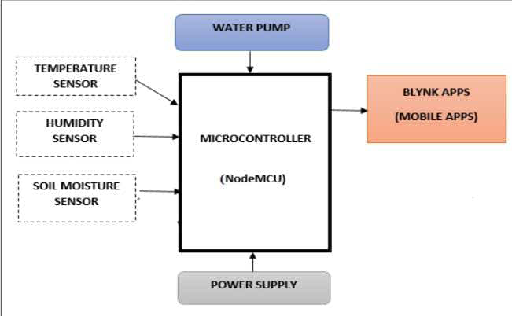
Flow diagram

Slide 9
Results

Slide 10
Conclusion

Slide 11
References

Slide 12
Thank You

